Slide 1
CUSTOMER
CHURN
ANALYSIS
FATHIMA

Slide 2
INTRODUCTION
The bank is facing challenges in maintaining customer loyalty and aims to address issues related to customer churn.
The primary goals are to reduce customer churn, improve service delivery, and enhance overall customer satisfaction.
The bank has provided comprehensive datasets including:
Customer demographics: Information about customers' age, gender, geography, etc.
Transaction details: Records of customer transactions and financial activities.
Customer exit information: Data on customers who have left the bank.
Active customer profiles: Current active customers and their account details.
You analyze these datasets as an Analytical CRM specialist to extract meaningful insights and provide strategic recommendations.

Slide 3
PROBLEM STATEMENT
You are an analytical CRM (Customer Relationship Management) specialist hired by a bank to extract meaningful insights from various customer-related datasets.
The bank aims to reduce customer churn, improve service delivery, and enhance customer satisfaction. They have provided you with datasets including customer demographics, transaction details, customer exit information, and active customer profiles.

Slide 4
BANK CRM OVERVIEW
This capstone project delves into Bank Customer Relationship Management (CRM). CRM empowers banks to build stronger relationships through data analysis.
Our CRM system serves as a strategic tool for fostering stronger connections with our customers. Its centralized customer data, enabling personalized interactions, targeted marketing, and effective issue resolution.
Through segmentation and analytics, we identify customer needs, preferences, and behaviors, empowering us to tailor offerings and experiences. With a focus on retention and satisfaction, our CRM drives loyalty, revenue growth, and operational efficiency.
Let’s explore the transformative power of CRM in banking.

Slide 5
DATA EXPLORATION
Data Profiling: Checked the data types of all the columns where Bank-date-of- joining was incorrectly assigned a text data type. I used an update query to change the data type to Date.
Data Cleaning: For accurate analysis, check the null values in all the tables.
Data Visualization: For understanding patterns, trends, and outliers in our dataset. A good dashboard can answer questions and bring insights to the table immediately, rather than forcing users to plow through data and figure out what is important to them.

Slide 6
DATA STORAGE & MANIPULATION
SQL Outputs Extracted meaningful insights from output of SQL queries (can be seen in Doc file)
PowerBI Visuals Created Dashboard and relevant charts & visuals in PowerBI, compliment to SQL outputs

Slide 7
RETAINED
CUSTOMER
7963
EXIT
CUSTOMER
2037
INACTIVE
CUSTOMER
5151
KEY METRICS
TOTAL CUSTOMER
10000
CREDITCARD
HOLDER
7055
NON
CREDITCARD HOLDER
2945

Slide 8
OBJECTIVE
IDENTIFY LOCATIONS
AND GENDER WHERE CHURN RATE IS MORE
ANALYZING THE CUSTOMER SEGMENTS FOR POTENTIAL CHURN
PROPOSE MEASURES
TO RETAIN CUSTOMERS FROM CHURN

Slide 9
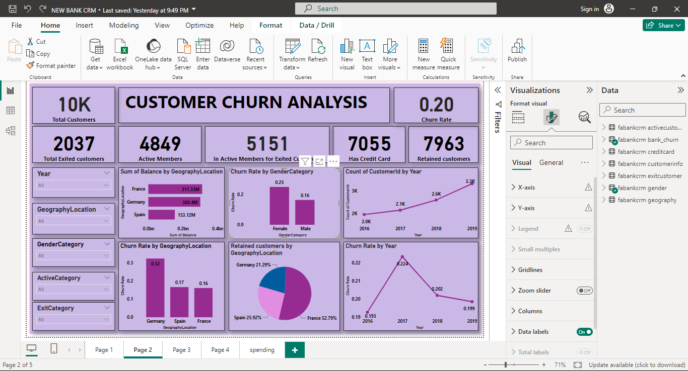
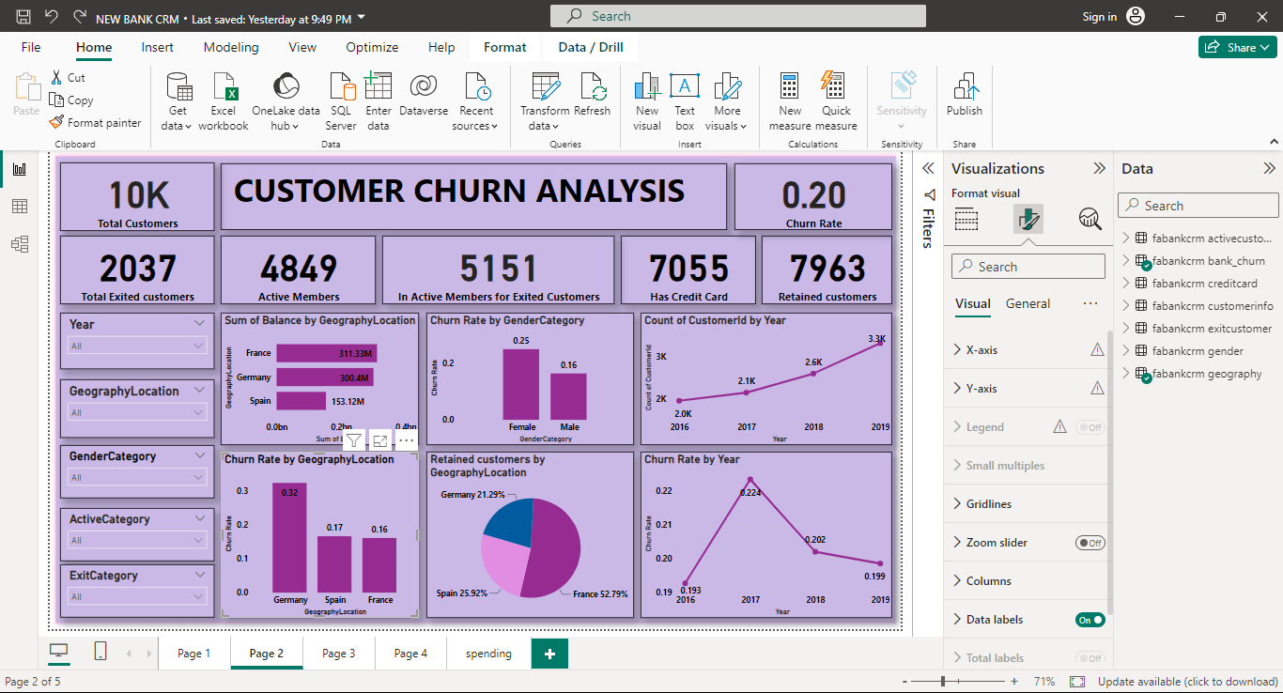
IDENTIFY LOCATIONS
AND GENDER WHERE CHURN RATE IS MORE
Insights: From the geography locations in the dataset, Germany has high churn rate compare to other countries.
Female customers have high churn rate compare to male customers.

Slide 10
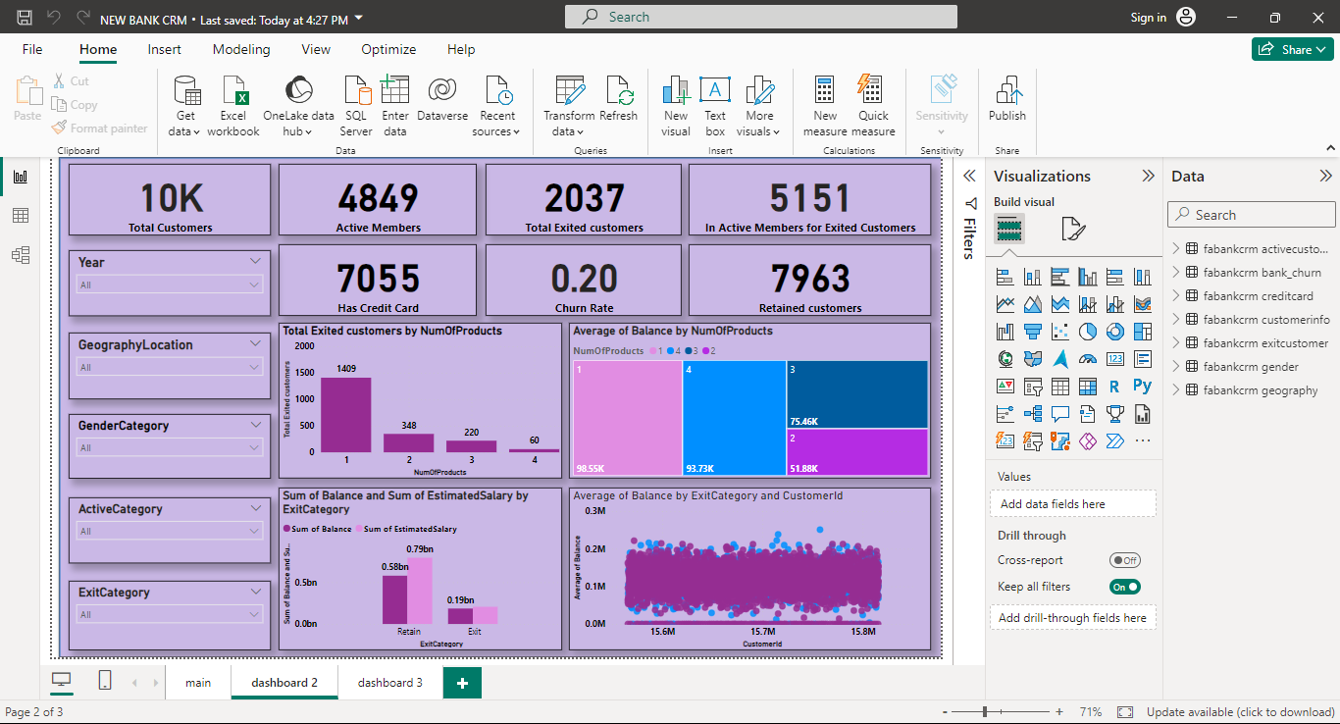
ANALYZING THE CUSTOMER SEGMENTS FOR POTENTIAL CHURN
Insights: Excited customers used only one product of the bank which makes a potential customer segment for churn.
Also credit score comes in poor category have highest churn rate which is 0.218 that could be a potential churn category.

Slide 11
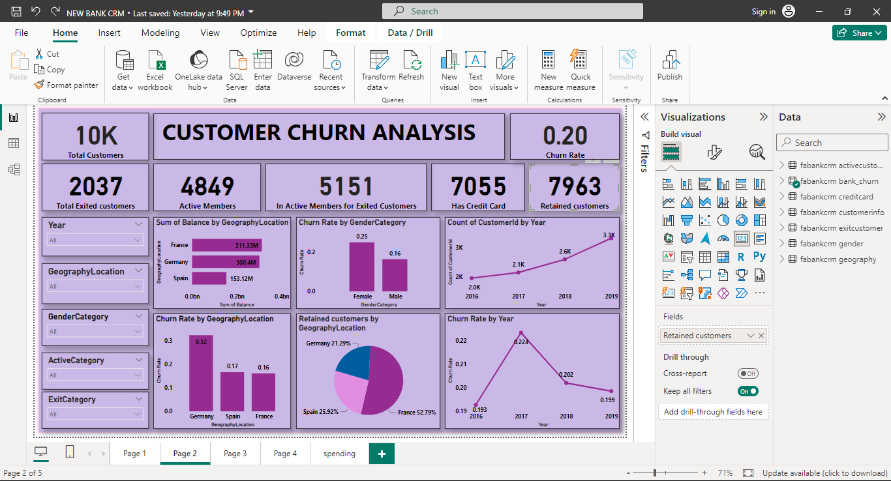
PROPOSE MEASURESTO DECREASE CHURN RATE
Insights: Number of customers joining the bank increases year to year which is good sign as well the churn rate also decreases year to year.
Take necessary steps to increase the joining of customers every year from which we can decrease the churn rate.
Also focus on country like Germany and France to take marketing measures to reduce chur rate as they have high churned customers 841 and 810 respectively.

Slide 12
DASHBOARD

Slide 13
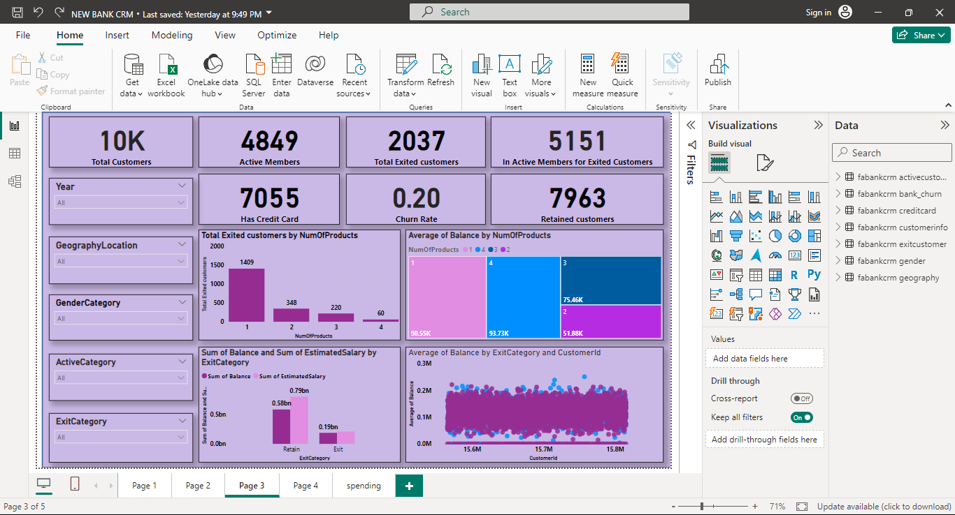

Slide 14
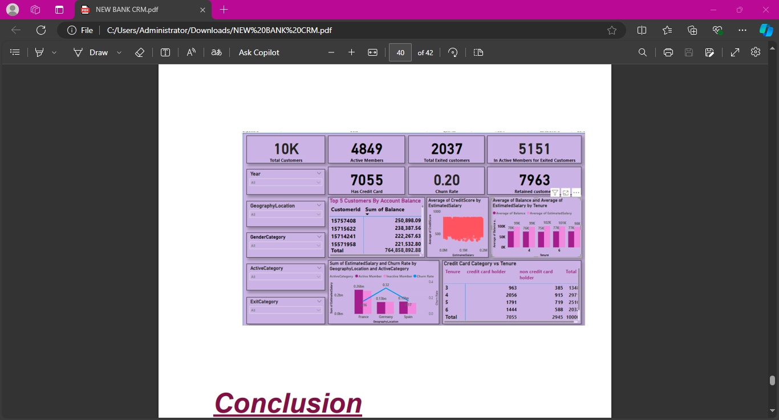

Slide 15
Conclusion
Effective use of CRM analytics can significantly reduce customer churn, improve service delivery, and enhance customer satisfaction.
The insights derived from the provided datasets offer valuable guidance for strategic decision-making.
Implementing the recommended actions will enable the bank to meet customer needs better and foster long-term loyalty.

Slide 16
THANKYOU

